Slide 1

Overview of
Data Communications
and
Networking

Slide 2
1.1 Data Communication
When we communicate, we are sharing information. This sharing can be local or remote. Between individuals, local communication usually occurs face to face, while remote communication takes place over distance.
The term telecommunication, which includes telephony, telegraphy, and television, means communication at a distance (tele is Greek for "far").
Data communications are the exchange of data between two devices via some form of transmission medium such as a wire cable.

Slide 3
Data communications system depends on four
fundamental characteristics:
Delivery: The system must deliver data to the correct destination.
Accuracy: The system must deliver the data in perfection way.
Timeliness: The system must deliver data in a timely manner. Data delivered late are useless. In the case of video and audio, This kind of delivery is called real-time transmission.
Jitter: Jitter refers to the variation in the packet arrival time (uneven delay). or A phenomenon in real-time traffic caused by gaps between consecutive packets at the receiver. (International Call)

Slide 4
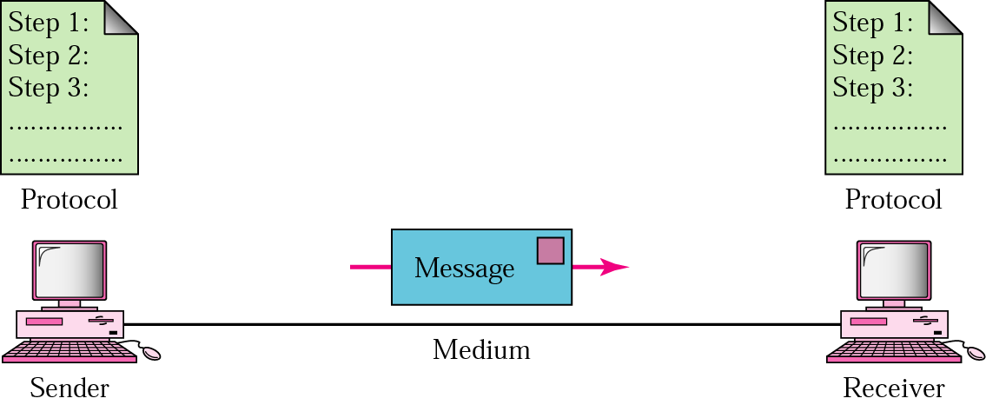
Components
A data communications system has five components:
Message: The message is the information (data) to be communicated. Popular forms of information include text, numbers, pictures, audio, and video.

Slide 5
2. Sender: The sender is the device that sends the data
message. It can be a computer, workstation,
telephone handset, video camera, and so on.
3. Receiver: The receiver is the device that receives the message. It can be a computer, workstation, telephone handset, television, and so on.
4.Transmission medium: The transmission medium is the physical path by which a message travels from sender to receiver. Like twisted-pair wire, coaxial cable, fiber-optic cable, and radio waves.
5. Protocol: A protocol is a set of rules that govern data communications. It represents an agreement between the communicating devices. Without a protocol, two devices may be connected but not communicating, just as a person speaking French cannot be understood by a person who speaks only Japanese.

Slide 6
Data Representation
Information today comes in different forms such as text, numbers, images, audio, and video.
Text: it is represented as a bit pattern, a sequence of bits (0 or 1).
For example: which uses 32 bits to represent a symbol or character.
2. Numbers: the number is directly converted to a binary number to simplify mathematical operations.
3. Images: an image is composed of a matrix of pixels (picture elements), where each pixel is a small dot. The size of the pixel depends on the resolution. After an image is divided into pixels, each pixel is assigned a bit pattern.

Slide 7
4. Audio: It is continuous, not discrete. Even when we use a microphone to change voice or music to an electric signal.
5. Video: It can either be produced as a continuous entity (e.g., by a TV camera), or it can be a combination of images, each a discrete entity, arranged to convey the idea of motion.

Slide 8
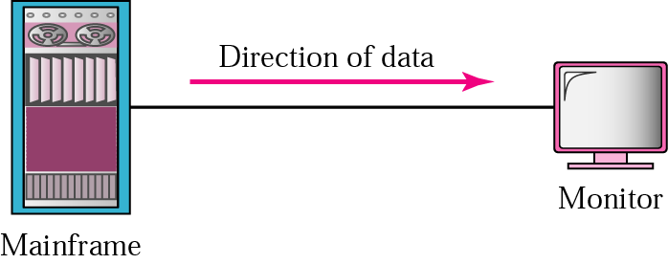
Data Flow
Communication between two devices can be simplex, half-duplex, and full-duplex
Simplex
The communication is unidirectional, as on a one-way street. Only one of the two devices on a link can transmit; the other can only receive. Such as keyboards and monitors.

Slide 9
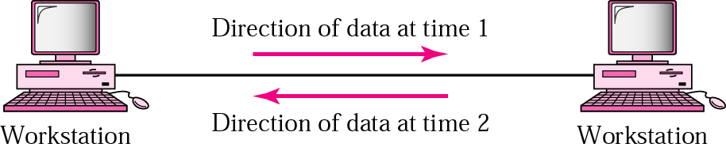
Half-Duplex
In half-duplex mode, each station can both transmit and receive, but not at the same time. Such as traffic allowed in both directions.

Slide 10
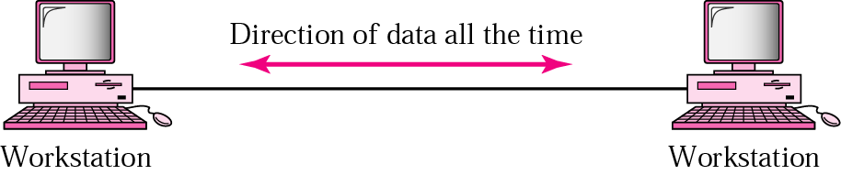
Full-Duplex
Both stations can transmit and receive simultaneously. One common example of full-duplex communication is the telephone network. When two people are communicating by a telephone line, both can talk and listen at the same time.

Slide 11
Networks
A network is a set of devices (often referred to as nodes) connected by communication links.
Distributed Processing
Most networks use distributed processing, in which a task is divided among multiple computers. Instead of one single large machine being responsible for all aspects of a process, separate computers handle a subset.

Slide 12
Network Criteria
The most important of these are performance, reliability, and security.
Performance:
Performance can be measured in many ways, including transit time and response time. Transit time is the amount of time required for a message to travel from one device to another. Response time is the elapsed time between an inquiry and a response.
The performance of a network depends on a number of factors including:
1. The number of users.
2. The type of transmission medium.
3. The capabilities of the connected hardware.
4. The efficiency of the software.

Slide 13
Reliability
In addition to accuracy of delivery, network reliability is measured by the frequency of failure, the time it takes a link to recover from a failure, and the network's robustness in a catastrophe.
Security
Network security issues include protecting data from unauthorized access, protecting data from damage and development, and implementing policies and procedures for recovery from breaches and data losses.

Slide 14
Physical Structures
Before discussing networks, we need to define some network attributes.
Type of Connection
A network is two or more devices connected through links. A link is a communications pathway that transfers data from one device to another.
There are two possible types of connections: point-to-point and multipoint.

Slide 15
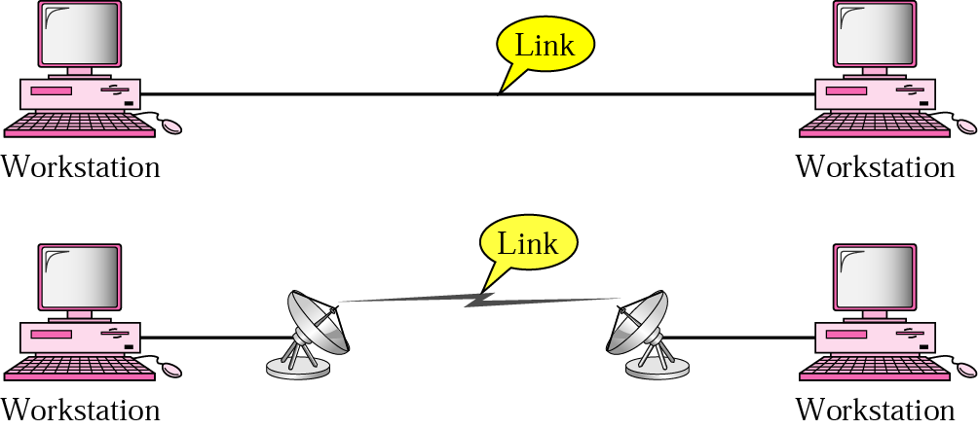
Point-to-Point
A point-to-point connection provides a dedicated link between two devices. Such as point-to-point connection between the remote control and the television's control system.

Slide 16
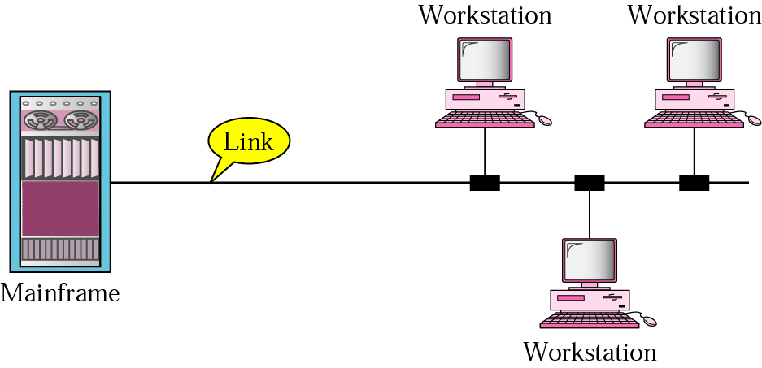
Multipoint
A multipoint (also called multidrop) connection is one in which more than two specific devices share a single link.

Slide 17
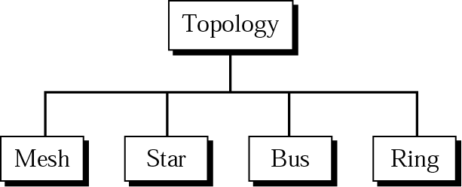
Physical Topology
There are four basic topologies possible:

Slide 18
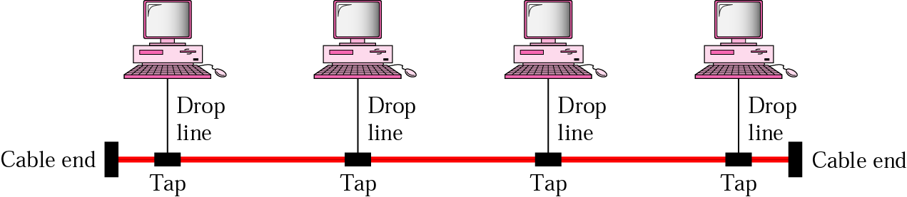
1. Bus Topology
One long cable acts as a backbone (main cable) to link
all the devices in a network.
Nodes are connected to the bus cable by drop lines and taps.
A drop line is a connection running between the device and the main cable.
A tap is a connector that either splices into the main cable or punctures the sheathing of a cable to create a contact with the metallic core. Such as T-Connector.

Slide 19
Advantages of a bus topology
Include easy for installation and cheaper than mesh or star topologies.
Disadvantages
Include difficult reconnection and fault isolation.
It can therefore be difficult to add new devices.
Signal reflection at the taps can cause degradation in quality. This degradation can be controlled by limiting the number and spacing of devices connected to a given length of cable.
The damaged area reflects signals back in the direction of origin, creating noise in both directions.
A fault or break in the bus cable stops all transmission

Slide 20

2. Ring Topology
In a ring topology, each device has a dedicated point-to-point connection with only the two devices on either side of it.
A signal is passed along the ring in one direction, from device to device, until it reaches its destination. Each device in the ring incorporates a repeater. When a device receives a signal intended for another device, its repeater regenerates the bits and passes them along.
Note: the repeater can indicate the direction of the signal.
input→ →output

Slide 21
Advantages:
A ring is relatively easy to install and reconfigure.
Fault isolation is easy.
Disadvantages:
A signal is circulating at all times. Need long time to send data between PC1 to PC5 because the cable is long.
Unidirectional traffic. In a simple ring, a break in the ring (such as a disabled station) can disable the entire network. This weakness can be solved by using a dual ring .
Unsecure because the data will pass through other computers.

Slide 22
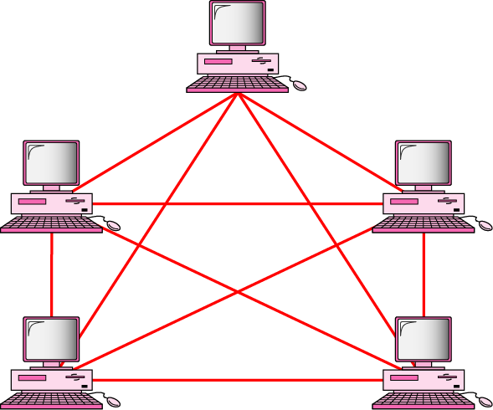
3. Mesh
In a mesh topology, every device has a dedicated point-to-point link to every other device. The term dedicated means that the link carries traffic only between the two devices it connects.
However, if each physical link allows communication in both directions, we can divide the number of links by 2.
Number of Links=n(n -1) /2
Every device on the network must have n – 1 or
Number of links for each device=n-1
Q/ Use mesh topology for connecting 4 nodes?

Slide 23
Mesh advantages
First, the use of dedicated links guarantees that each connection can carry its own data load, thus eliminating the traffic problems that can occur when links must be shared by multiple devices.
Second, a mesh topology is powerful. If one link becomes unusable, it does not breakdown the entire system (use another path).
Third, there is the advantage of privacy or security. When every message travels along a dedicated line, only the intended recipient sees it. Physical boundaries prevent other users from gaining access to messages.

Slide 24
Disadvantages
Firstly, because every device must be connected to every other device, installation and reconnection are difficult , it is expensive .
the hardware required to connect each link (I/O ports and cable) can be prohibitively expensive.
Secondly, the sheer bulk of the wiring can be greater than the available space (in walls, ceilings, or floors) can accommodate.
Application: One practical example of a mesh topology is the connection of telephone regional offices in which each regional office needs to be connected to every other regional office.

Slide 25
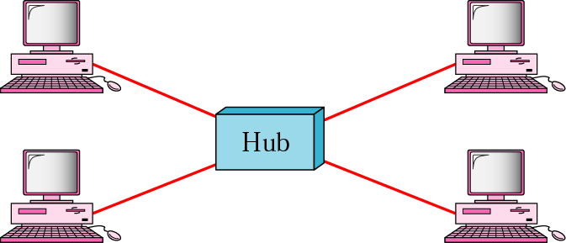
4. Star Topology
In a star topology, each device has a dedicated point-to-point link only to a central controller, usually called a hub or switch. It does not allow direct traffic between devices.
The controller acts as an exchange: If one device wants to send data to another, it sends the data to the controller, which then relays the data to the other connected device.
Hub: to distribute and management of data.

Slide 26
Advantages:
First, A star topology is less expensive than a mesh topology. In a star, each device needs only one link and one I/O port to connect it to any number of others. This factor also makes it easy to install and reconfigure.
Second, far less cabling.
Third, advantages include robustness. If one link fails, only that link is affected. All other links remain active.
One big disadvantage of a star topology is the dependency of the whole topology on one single point, the hub. If the hub goes down, the whole system is dead.

Slide 27
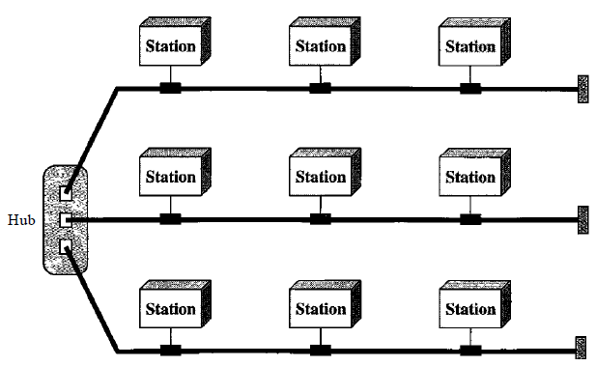
5. Hybrid Topology
A network can be hybrid. For example, we can have a
main star topology with each branch connecting several stations in a bus topology as shown below.
a star backbone with three bus networks

Slide 28
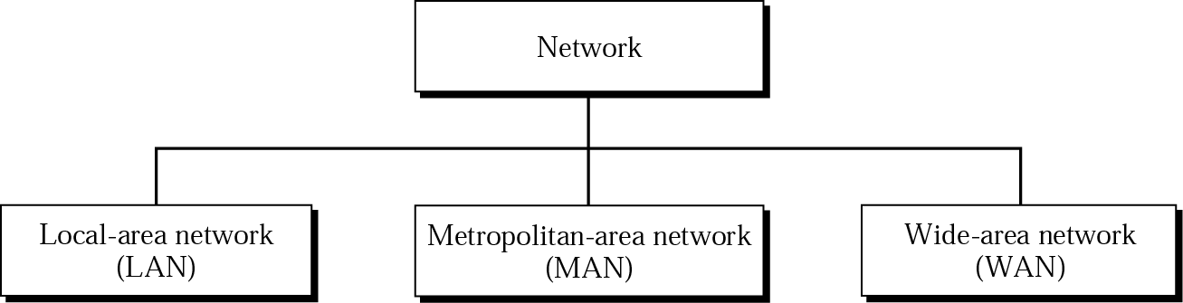
Categories of Networks

Slide 29

Local Area Network (LAN)
A local area network (LAN) is usually privately owned and links the devices in a single office, building, or campus as shown below.
An isolated LAN connecting 12 computers to a hub in a closet

Slide 30
LAN can be as simple as two PCs and a printer in
someone's home office; or it can extend throughout a
company.
LAN size is limited to a few kilometers.
Main Goal: LANs are designed to allow resources to be shared between personal computers or workstations. The resources to be shared can include hardware (e.g., a printer), software (e.g., an application program), or data.
One of the computers may be given a large capacity disk drive and may become a server to clients. Software can be stored on this central server and used as needed by the whole group.
The most common LAN topologies are bus, ring, and star.
LANs had data rates are: 4 -16 Mbps,100 Mbps and 1Gigabps
Wireless LANs are the newest evolution in LAN technology.

Slide 31
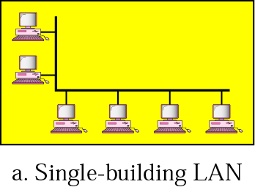
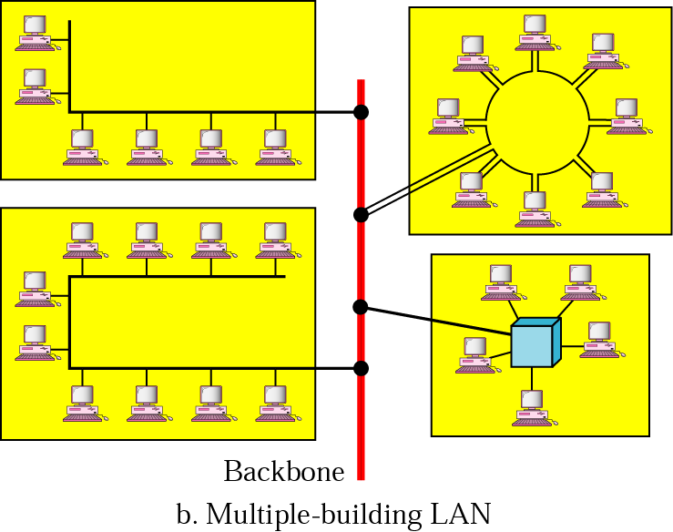

Slide 32
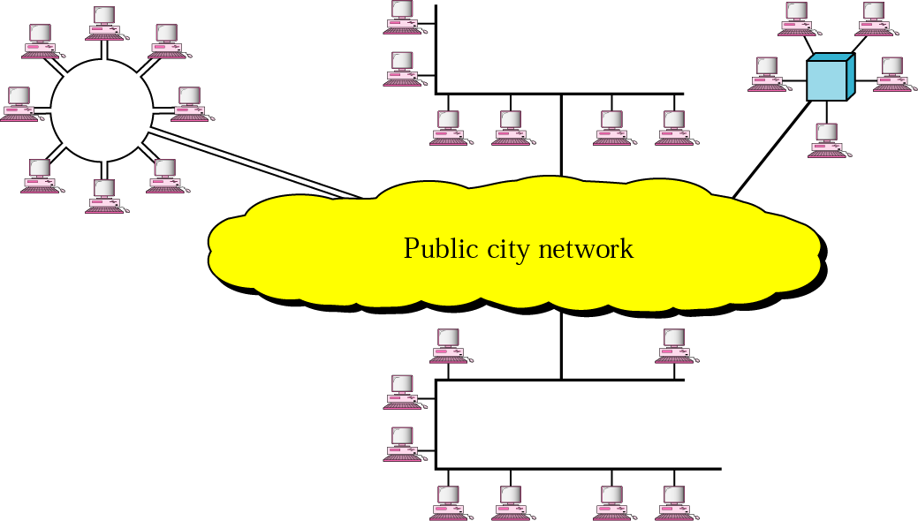
Metropolitan Area Network (MAN)
It normally covers the area inside a town or a city.

Slide 33
It is designed for customers who need a high-speed connectivity.
A good example of a MAN is the part of the telephone company network that can provide a high-speed DSL line to the customer. Another example is the cable TV network that originally was designed for cable TV.
DSL: Digital subscriber line

Slide 34
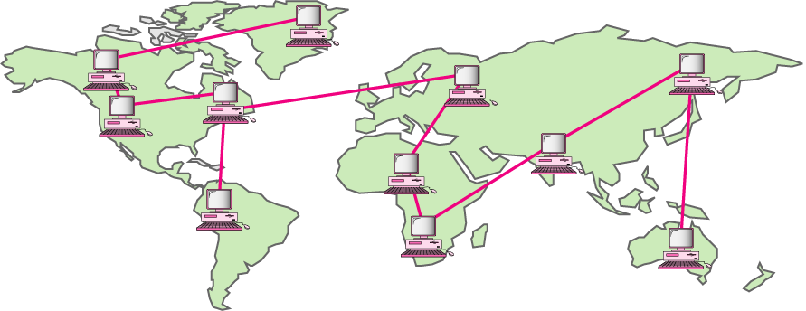
Wide Area Network (WAN)
A wide area network (WAN) provides long-distance transmission of data, image, audio, and video information over large geographic areas that may comprise a country, a continent, or even the whole world.
A WAN can be as complex as the backbones that connect the Internet.

Slide 35
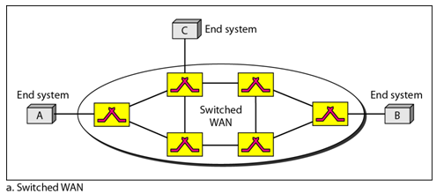
A WAN can be as complex as the backbones that connect the Internet or simple as a dial-up line that connects a home computer to the Internet. We normally refer to the first as a switched WAN and to the second as a point-to-point WAN.
Switched WAN
The switched WAN connects the end systems, which usually comprise a router (internetworking connecting device) that connects to another LAN or WAN.

Slide 36
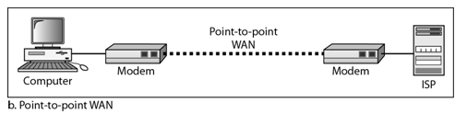
B. point-to-point WAN
The point-to-point WAN is normally a line leased from a telephone or cable TV provider that connects a home computer or a small LAN to an Internet service provider (lSP). (Modem or Router)

Slide 37

Interconnection of Networks:
Internetwork
When two or more networks are connected, they become an internetwork, or internet.

Slide 38
To create a backbone WAN for connecting these three entities (two LANs and the president's computer), a switched WAN (operated by a service provider such as a telecom company) has been leased.
To connect the LANs to this switched WAN, however, three point-to-point WANs are required.
These point-to-point WANs can be a high-speed DSL line offered by a telephone company or a cable modern line offered by a cable TV provider as shown.
Q/ Describe categories of network (LAN, MAN and WAN) according to the following parameters:
1. Size 2. Ownership 3. Distance it cover 4. Physical architecture

Slide 39
The Internet
The Internet is a communication system that has brought a wealth of information to our fingertips and organized it for our use.
A Brief History
An internet (note the lowercase letter i) is two or more networks that can communicate with each other. The most notable internet is called the Internet (uppercase letter I), a collaboration of more than hundreds of thousands of interconnected networks.

Slide 40
In 1972, Vint Cerf and Bob Kahn, both of whom were part of the core ARPANET group, collaborated on what they called the Internetting Project. Cerf and Kahn's landmark 1973 paper outlined the protocols to achieve end-to-end delivery of packets. This paper on Transmission Control Protocol (TCP) included concepts such as encapsulation, the datagram, and the functions of a gateway.
Shortly thereafter, authorities made a decision to split TCP into two protocols: Transmission Control Protocol (TCP) and Internetworking Protocol (lP). IP would handle datagram routing while TCP would be responsible for higher-level functions such as segmentation, reassembly, and error detection. The internetworking protocol became known as TCP/IP.

Slide 41
The Internet Today
Today most end users who want Internet connection use
the services of Internet service providers (ISP). There are :
International Service Providers
National Service Providers
Regional Service Providers
Local Service Providers
The Internet today is run by private companies, not the government.

Slide 42

Hierarchical organization of the Internet

Slide 43
International Internet Service Providers
At the top of the hierarchy are the international service providers that connect nations together.
National Internet Service Providers
To provide connectivity between the end users, these backbone
networks are connected by complex switching stations (normally run by a third party) called network access points (NAP: for connecting two countries). Some national ISP networks are also connected to one another by private switching stations called peering points.

Slide 44
Regional Internet Service Providers
Regional internet service providers or regional ISPs are smaller ISPs that are connected to one or more national ISPs. They are at the third level of the hierarchy with a smaller data rate.
Local Internet Service Providers
Local Internet service providers provide direct service to the end users. The local ISPs can be connected to regional ISPs or directly to national ISPs. Most end users are connected to the local ISPs. A local ISP can be a company that just provides Internet services.

Slide 45
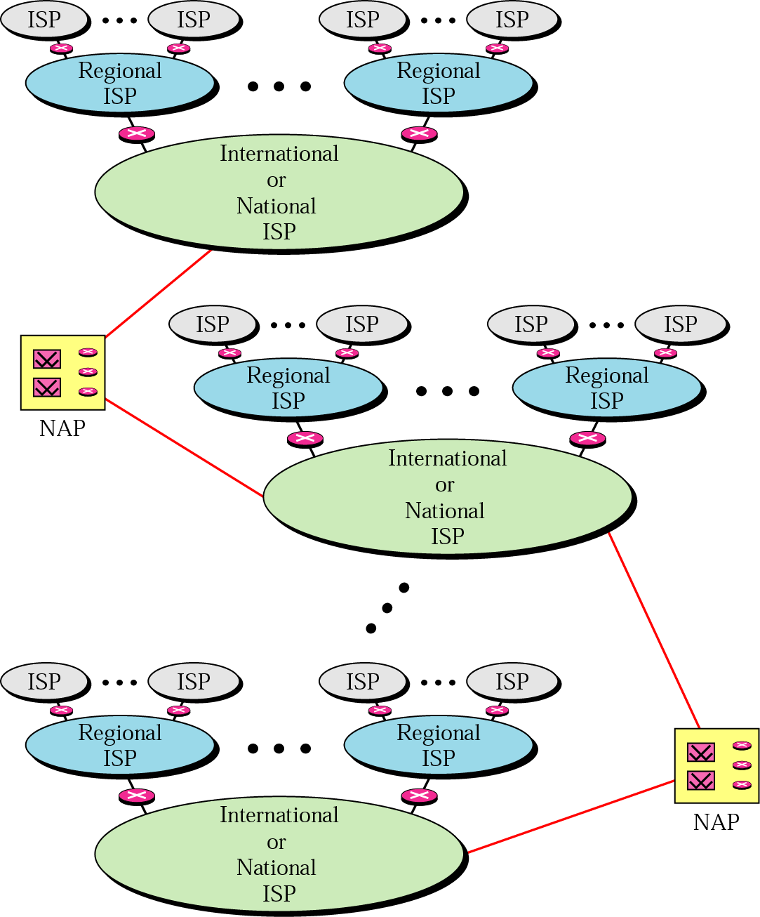
Internet today

